Slide 1




SAY
HELLO
TO
SAILO!
TEAM 1
NARCISA BACAU, CHRISTOPHER BEER, LEVENTE KÁDÁR, KARL JUHANDI, ANA ZHU AND MARKO ORLOV
EPS@ISEP 2019

Slide 2
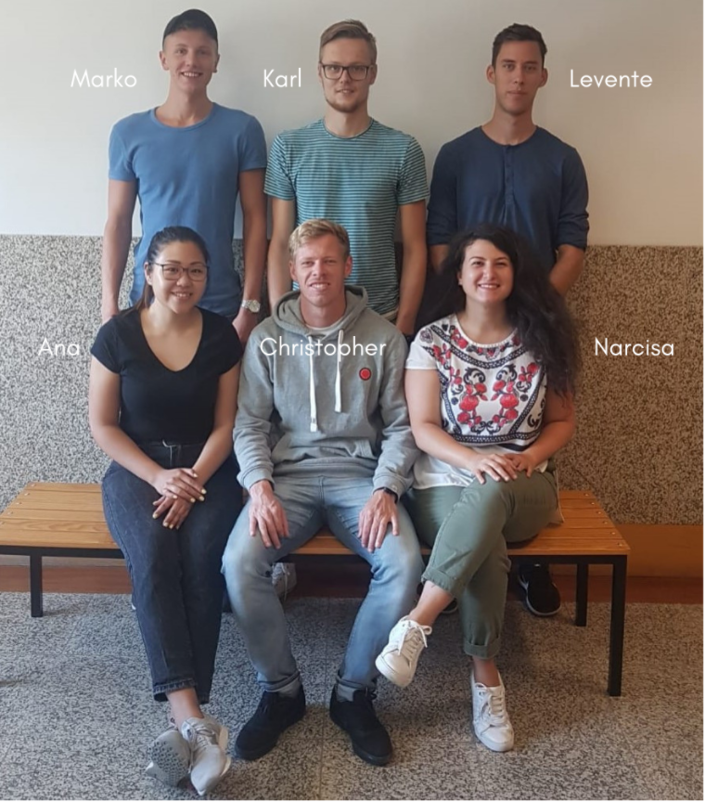
THE TEAM
Electrical engineering
Logistics
Product management
Mechanical engineering
Engineering and management

Slide 3
  Problem Statement & Research
  The Project Management
  Project Development
  Conclusion
PRESENTATION OUTLINE

Slide 4
PROBLEM
STATEMENT
&
RESEARCH

Slide 5

THE PROBLEM
What thrives us?
  Earth's natural resources are limited
  Promote the use of wind as the main resource
What do we want to achieve?
  Contributing to a better world
  Raise awareness about a green sport and leisure activity
“I can’t change the direction of the wind, but I can adjust my sails to always reach my destination.”
JIMMY DEAN

Slide 6

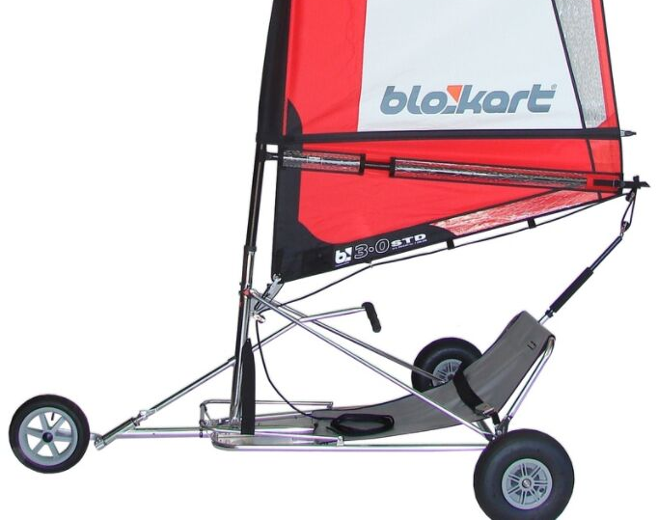
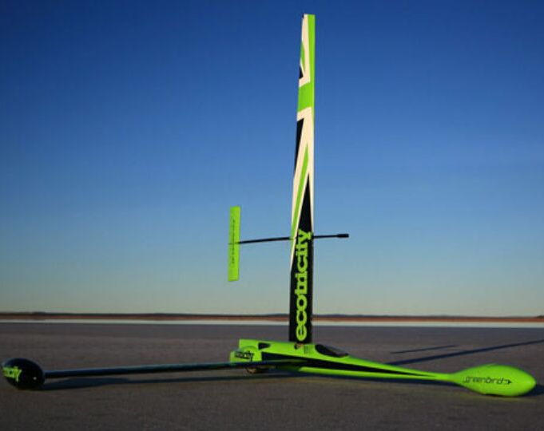

RESEARCH
What we wanted to implement from others?
Three wheeled
Light frame
Dissassembable
Rigid sail with a tail
Self-correcting system

Slide 7
MARKETING
How we got from the technical idea to user perspective?
Requirements
Features
Functionalities
(What we knew in the beginning)
(Technical research)
(Marketing research)
Prototype
Selling product

Slide 8
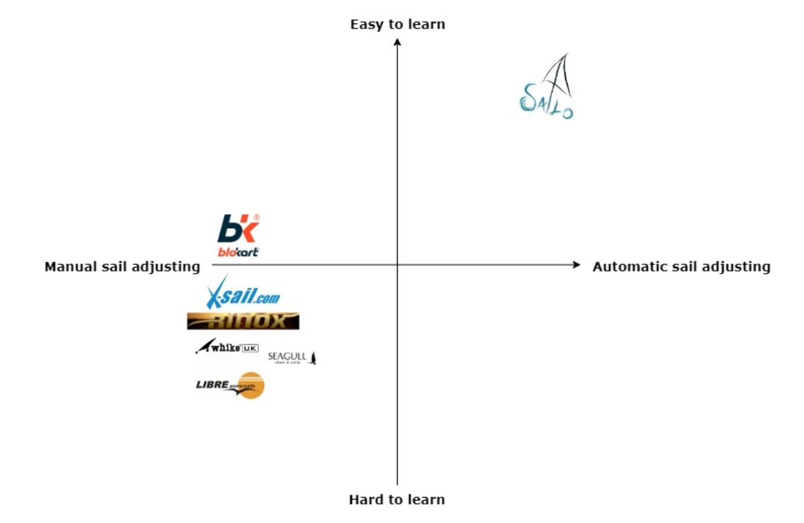
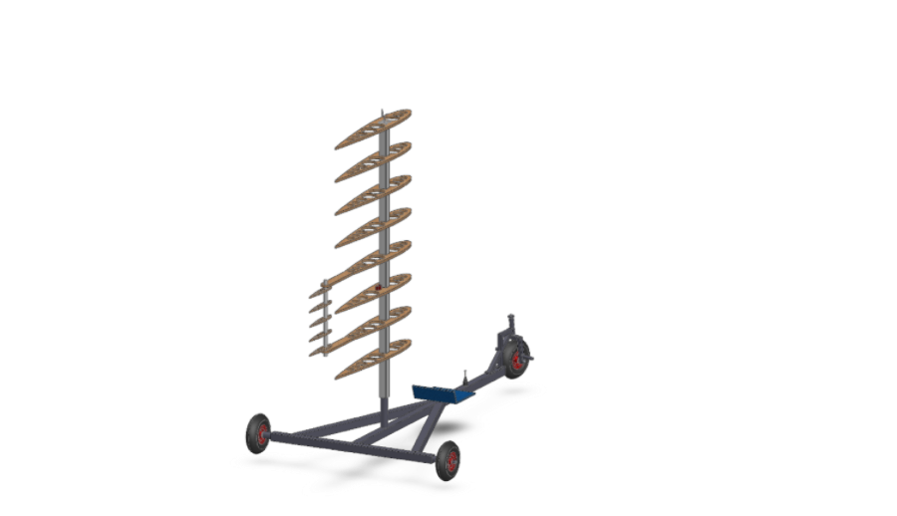
PERCEPTUAL MAP

Slide 9
PROJECT
MANAGEMENT

Slide 10
SCRUM
Reality:
  First half of the semester was perfect
  Building planning less organized
  Unexpected issues
  Missing members
  Changing the sprint length
Initial plan:
  Sprint based planning
  1 week sprints, Thu-Wed
  Project backlog
  Daily standups
  Retrospective

Slide 11
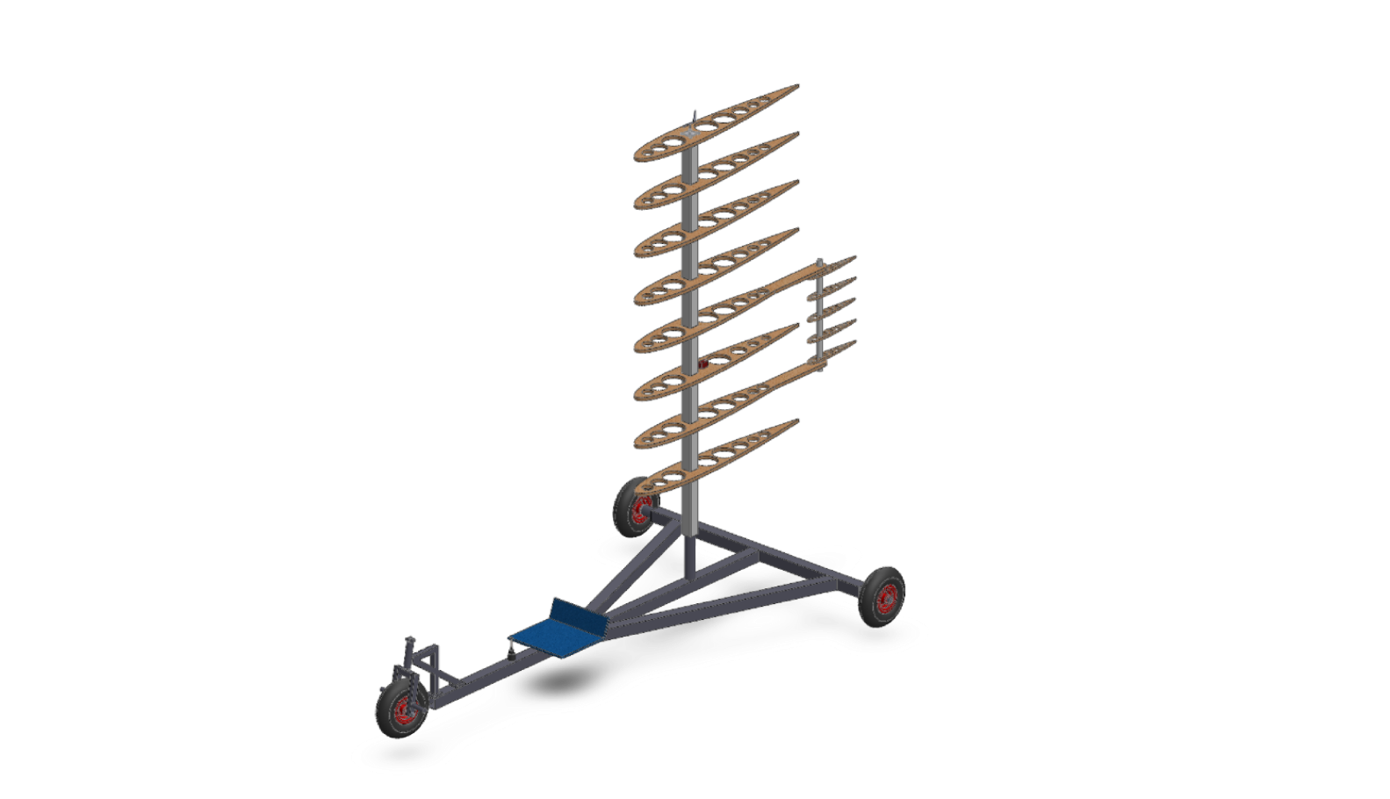
SUSTAINABILITYAND ETHICS
Currently:
  Power source - wind
  Mast - sustainable material
  Seat - recycled
  Electronics - lead-free
In the future:
  Frame - aluminium
  Wing - recycled wood or composite
  Wing cover - biodegradable plastics

Slide 12
PROJECT
DEVELOPMENT

Slide 13
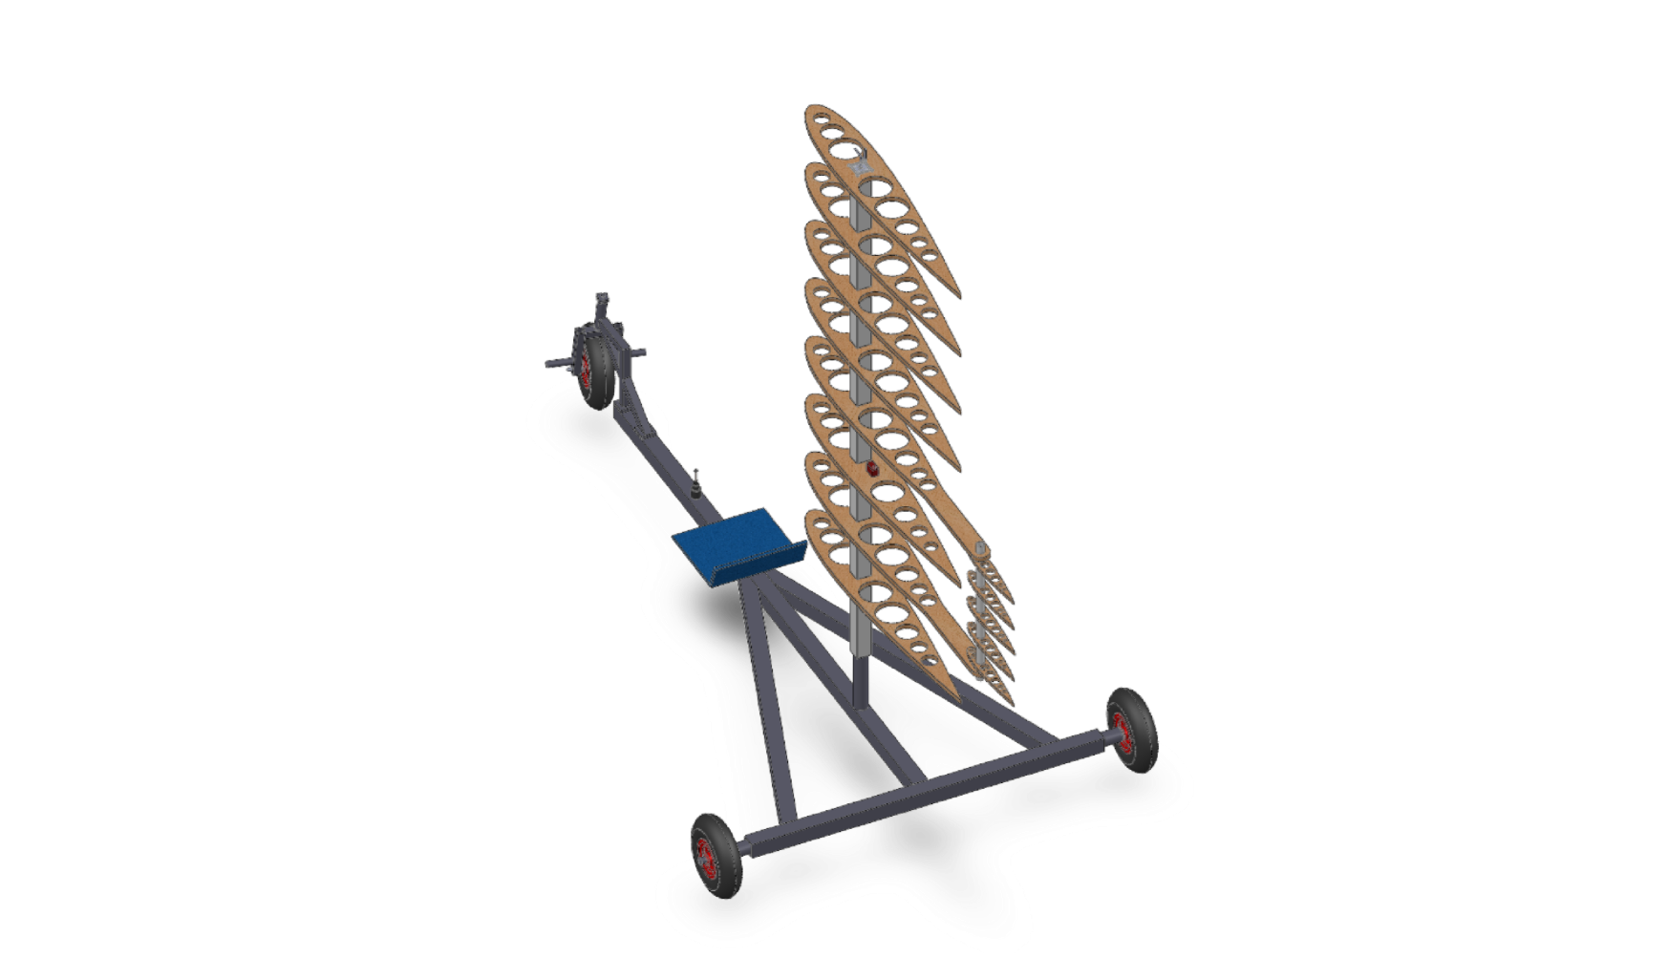
DESIGN
Mechanical functions:
  Wing and tail
  Frame
  Other components
Electrical functions:
  Servo motor
  Wind sensor
  Joystick

Slide 14
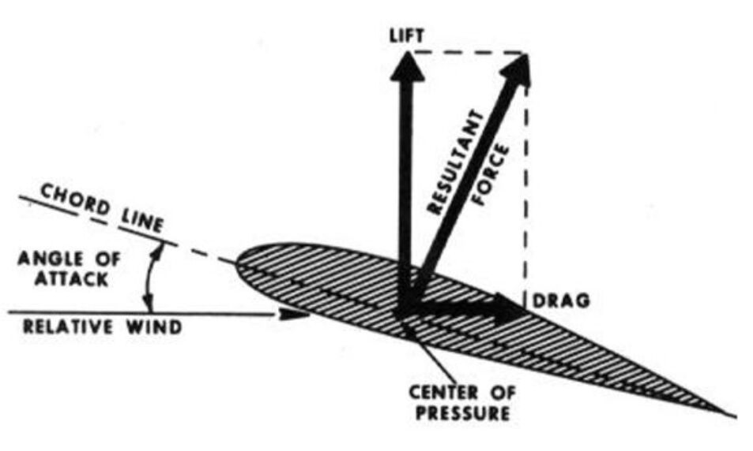
FUNCTION OF THE WING
  Symmetric shape - in all directions​
  Lift - perpendicular to apparent wind​
  Drag - same direction as the apparent wind ​
  Resultant force - sum of Lift and Drag​
  NACA 0015 – calculated the most Lift
α= 14° most lift​
α= 6.25°
most lift/drag​

Slide 15
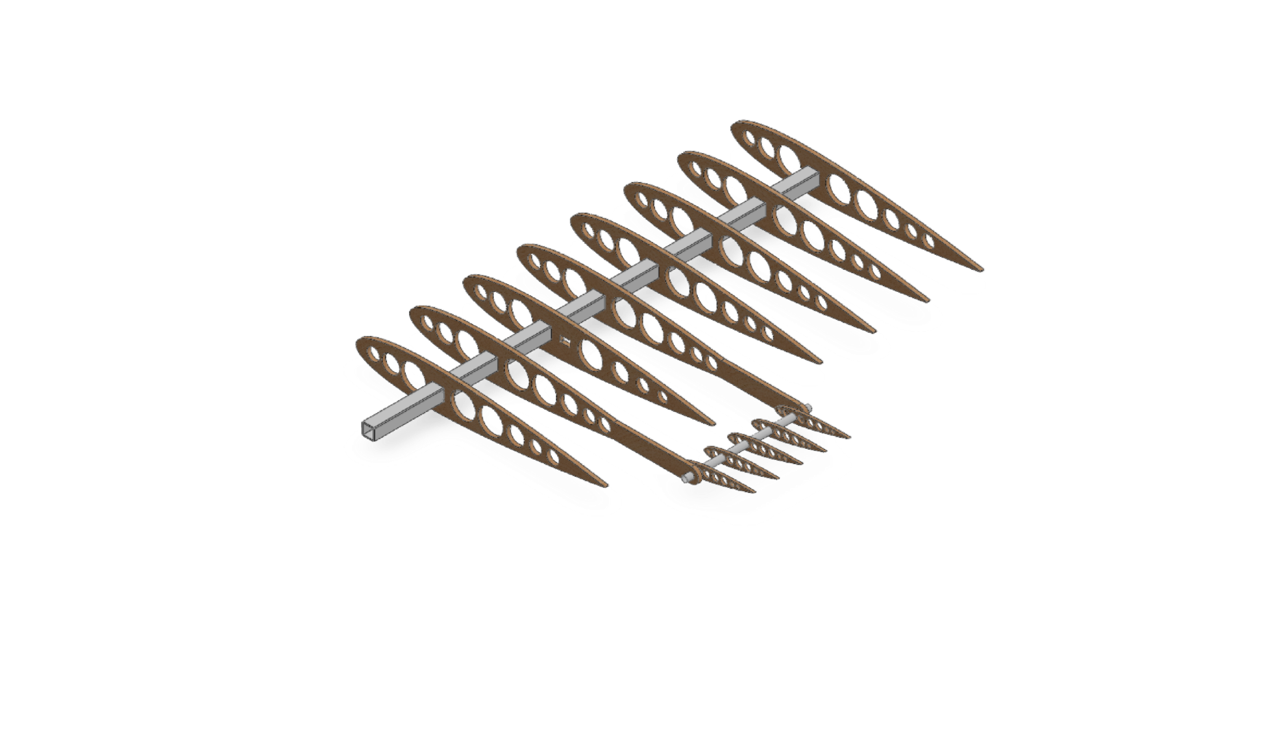
FUNCTION OF THE TAIL
  Use the tail to steer the main wing​
  Tail steered by servo motor​
  Less energy needed
  Aluminium rods

Slide 16
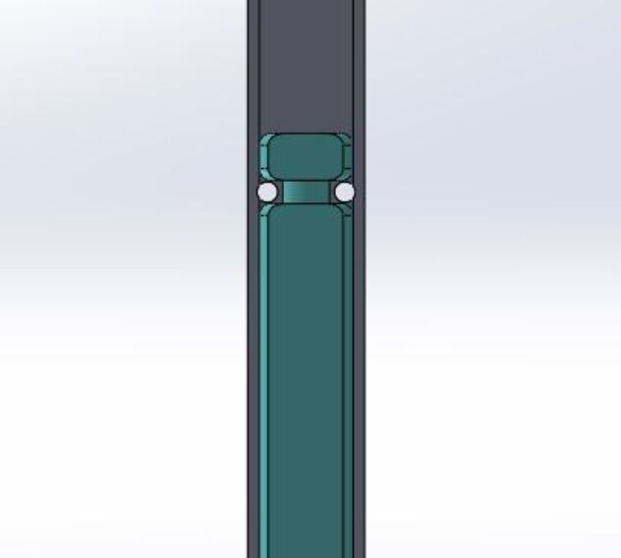
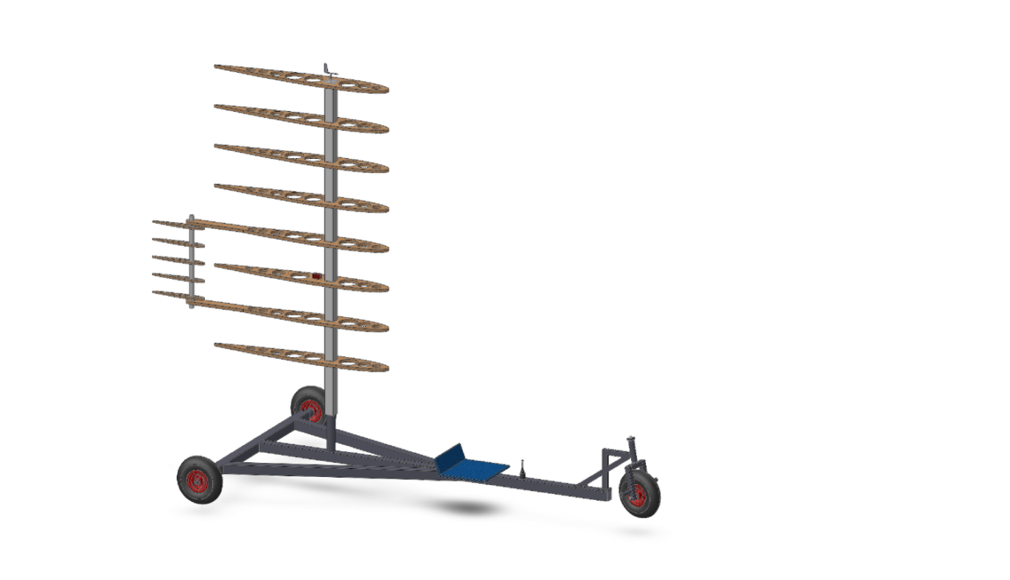
MAST CONNECTION
  Allows rotation
  Connection of the mast to the frame
  Two screws and nuts
  ∅45 mm

Slide 17
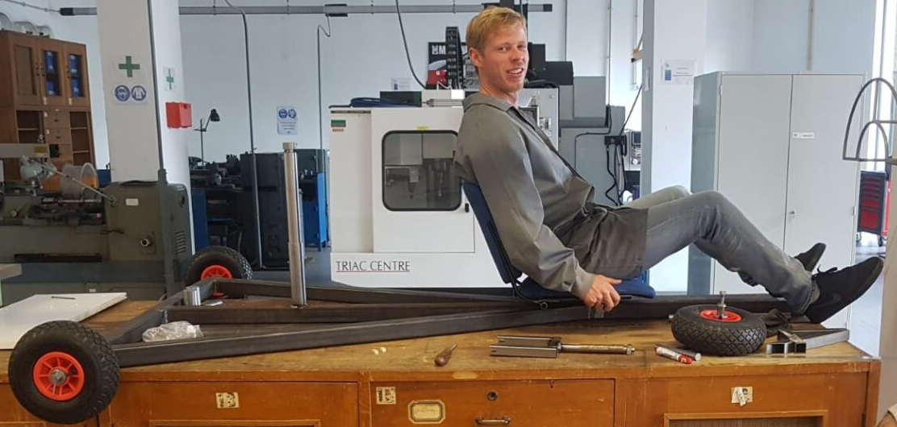
FRAME

Slide 18
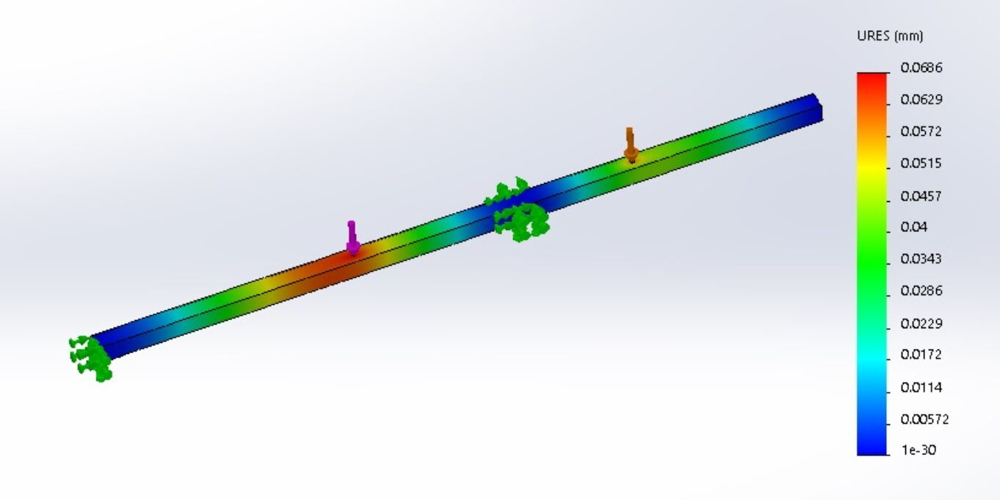
FRAME
Solidworks simulation:
  Maximum displacement of 0.07 mm
  Structural steel S235
  50 x 50 x 3 mm
  F1 = 800 N
  F2 = 400 N
F2
F1

Slide 19
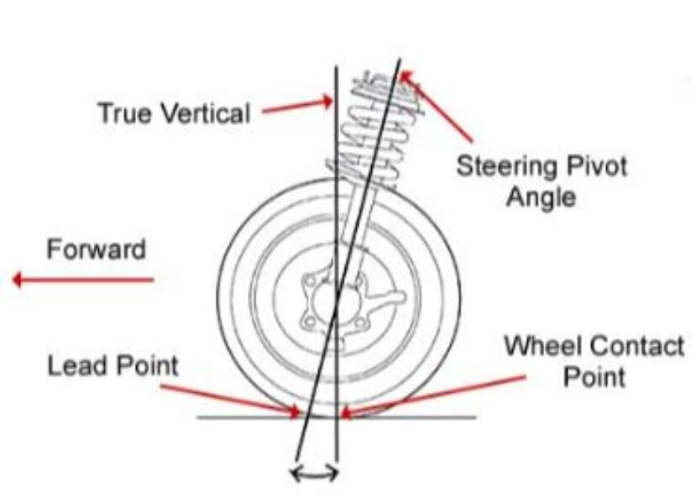
FRONT WHEEL STEERING
First solution: wrong caster angle​
  A torque was created which turned the front wheel​
  Wheel fell to the side​
Final Solution: caster angle of 10°​
  Torque steers to straight - ahead position
  Wheel is not falling to the side

Slide 20
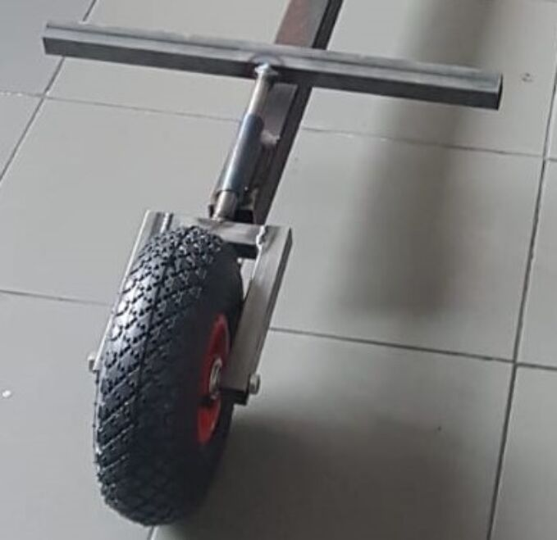
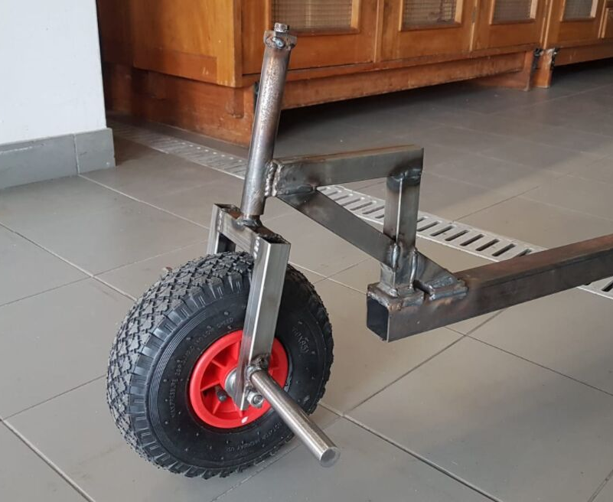
FRONT WHEEL STEERING
First solution
Final solution

Slide 21
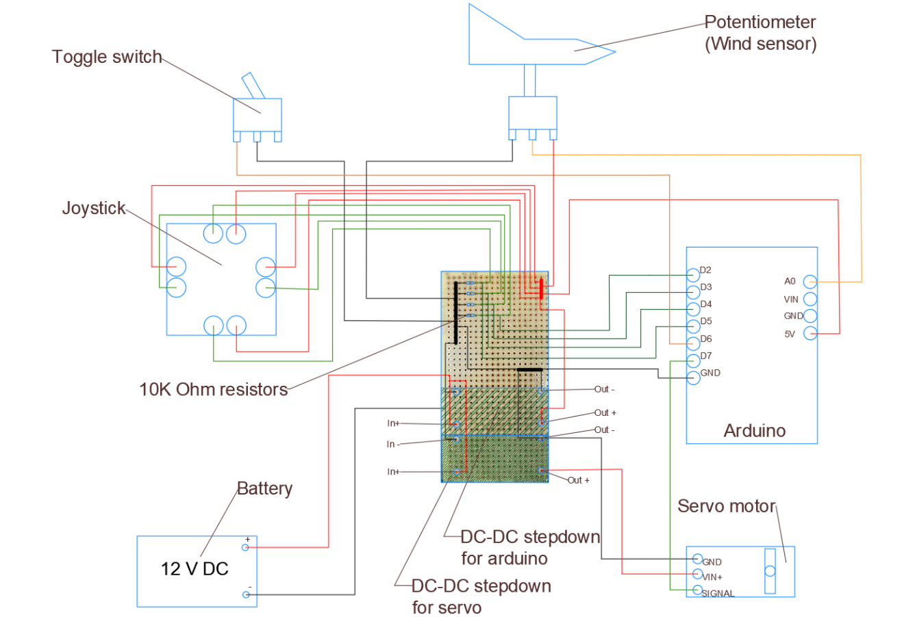
ELECTRONICS

Slide 22
FUTURE DEVELOPMENT
  Reliable braking system
  Lighter materials
  Adjustable seat system
  Wireless connection between electronic components
  Additional electronic parts

Slide 23





ACKNOW-LEDGEMENT
Mechanical workshop and technicians
The
Teachers
The Supervisors

Slide 24
ANY
QUESTIONS?

